Slide 1

Vehicle Insurance
Chinmay Maganur

Slide 2

Goal:
Building a model to predict whether a customer would be interested in Vehicle Insurance is extremely helpful for the company because it can then accordingly plan its communication strategy to reach out to those customers and optimize its business model and revenue.

Slide 3
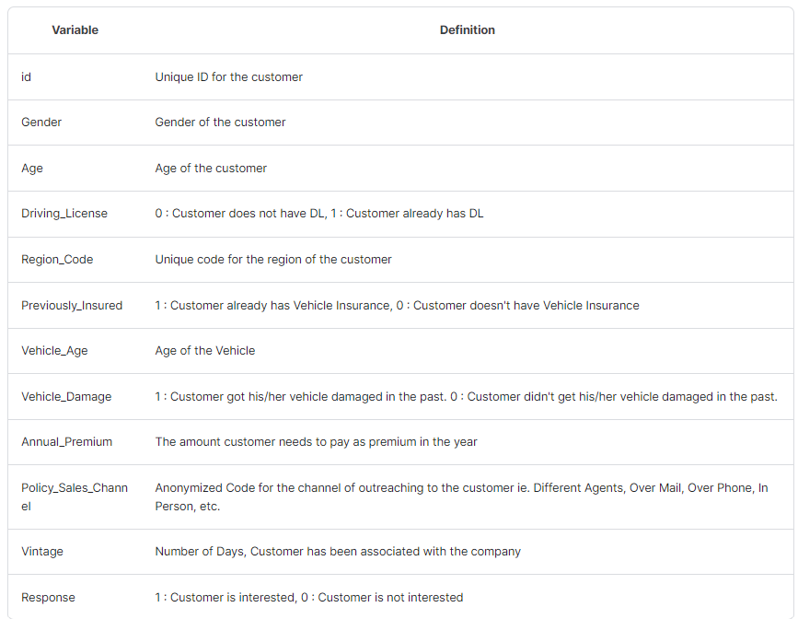
About Data:

Slide 4
Hypothesis:
Customers may be inclined to buy insurance for new or recently purchased vehicles.
The cost of insurance is a significant consideration for customers.
Having a driving license can be a motivating factor for purchasing vehicle insurance.
In terms of targeting customers for insurance sales:
Target owners of older vehicles due to the increased risk of malfunctions.
Focus on individuals who are currently without insurance as they represent a new market.
Investigate and utilize effective strategies for customer outreach.

Slide 5
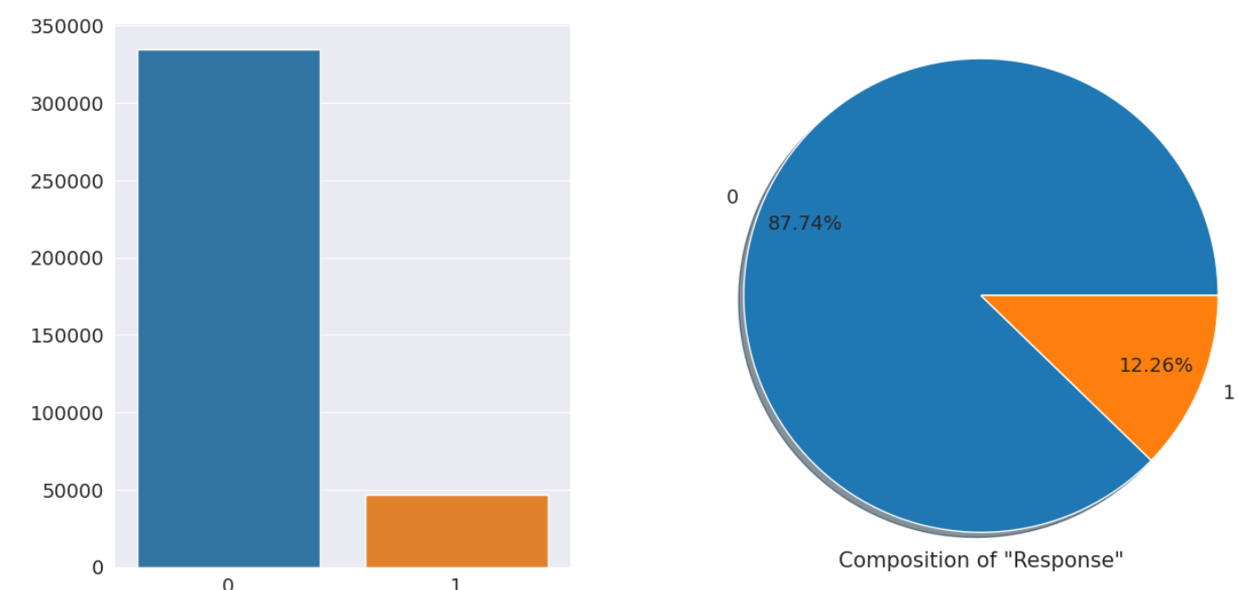
Explorative Data Analysis
Distribution of Target Variable:
Our data is heavily imbalanced with 87.74% of data have Response of 0 and just over 12% with Response 1 (People who are interested in buying Insurance)

Slide 6
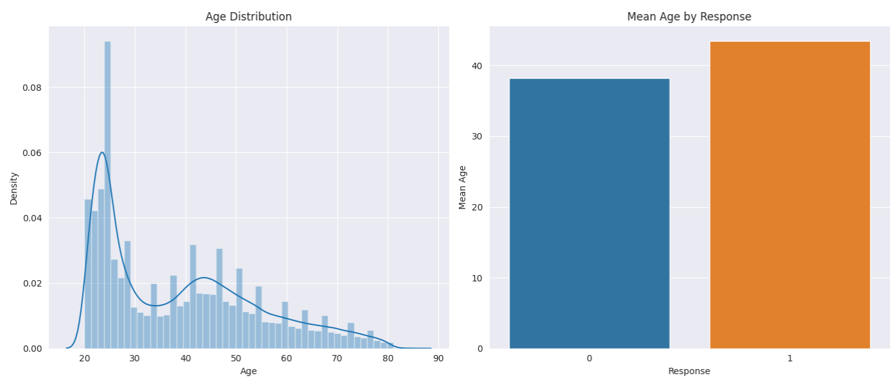
Age vs Response
The majority of the population falls within the age range of 20 to 27 years.
The average age of individuals interested in purchasing insurance is approximately 45 years.
Those who are not interested in purchasing insurance have an average age of about 37 years.

Slide 7
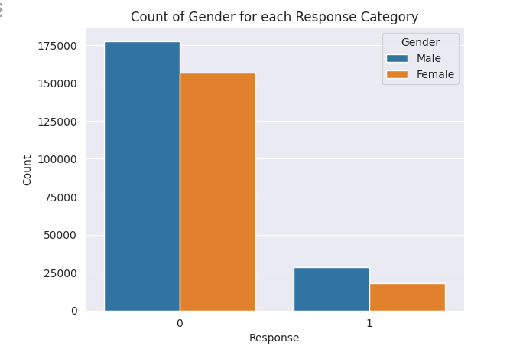
Gender vs Response
The bar chart illustrates the gender breakdown of responses to accepting insurance, with males more likely to decline and females more likely to accept insurance.

Slide 8
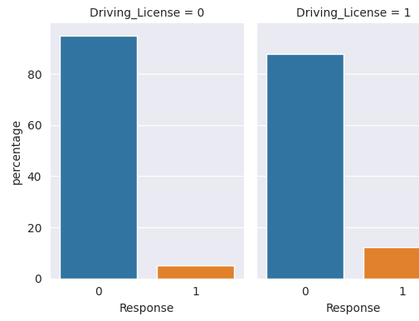
DL vs Response
Individuals without a driving license (Driving_License = 0) mostly decline insurance.
A very small percentage of those without a driving license accept insurance.
Individuals with a driving license (Driving_License = 1) are more inclined to accept insurance.
Despite having a driving license, there is still a notable portion that declines insurance.
Possession of a driving license seems to correlate with a higher likelihood of accepting insurance.

Slide 9
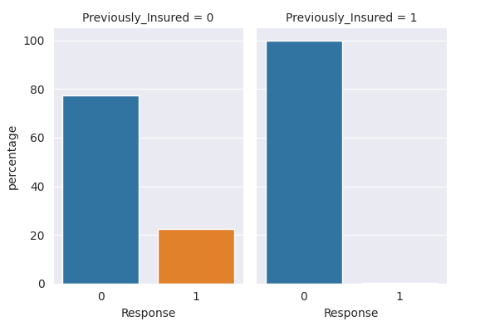
Prev Insurance vs Response
Individuals not previously insured (Previously_Insured = 0) show a higher likelihood of declining insurance (Response 0).
A smaller proportion of those not previously insured are willing to accept insurance (Response 1).
Individuals who were previously insured (Previously_Insured = 1) exhibit an overwhelmingly high acceptance rate for insurance (Response 1).
The response of previously insured individuals to decline insurance (Response 0) is minimal.

Slide 10
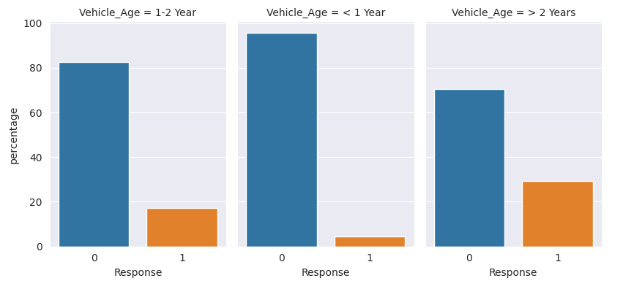
Vehicle Age vs Response
For vehicles aged 1-2 years, a majority did not accept insurance (Response 0), with a smaller percentage accepting (Response 1).
Vehicles less than 1 year old show a high insurance acceptance rate (Response 1) and a lower non-acceptance rate (Response 0).
Vehicles older than 2 years have a balanced distribution, with a notable percentage declining insurance (Response 0) and a significant proportion accepting it (Response 1)

Slide 11

Preprocessing
Converting categorical values to int/float
Null value analysis
Feature Engineering
Correlation Analysis

Slide 12
Model Results
RF | precision | recall | f1-score | support
0 | 0.89 | 0.97 | 0.93 | 100320
1 | 0.36 | 0.14 | 0.2 | 14013
accuracy |  |  | 0.86 | 114333
macro avg | 0.63 | 0.55 | 0.56 | 114333
weighted avg | 0.82 | 0.86 | 0.84 | 114333
LGBM | Precision | Recall | F1-score | Support
0 | 0.88 | 1 | 0.93 | 100320
1 | 0.26 | 0 | 0.01 | 14013
accuracy | 0.88 | 0.88 | 0.82 | 114333
macro avg | 0.57 | 0.5 | 0.47 | 114333
weighted avg | 0.8 | 0.88 | 0.82 | 114333
XGBOOST | precision | recall | f1-score | support
0 | 0.88 | 0.99 | 0.93 | 100320
1 | 0.45 | 0.03 | 0.06 | 14013
accuracy | 0.88 | 0.88 | 0.88 | 114333
macro avg | 0.66 | 0.51 | 0.5 | 114333
weighted avg | 0.83 | 0.88 | 0.83 | 114333

Slide 13

Balancing Data

Slide 14

Smote
Smote stands for synthetic minority over-sampling technique.
Increases the number of instances in the minority class to balance dataset.
Generates synthetic samples rather than duplicating existing ones.
Works by interpolating between existing minority class instances.
Identifies k-nearest neighbors for minority instances to create new samples.

Slide 15
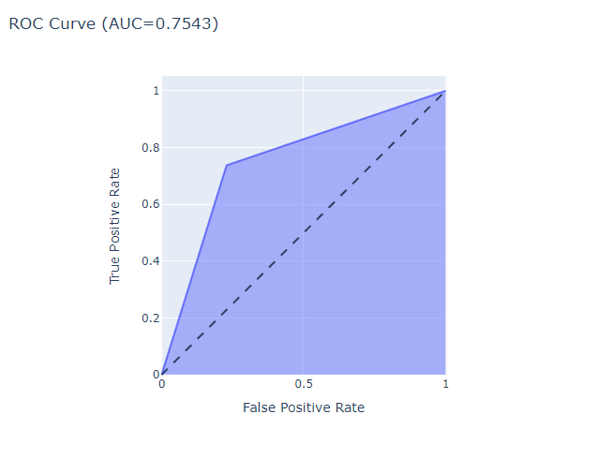
Results
 | precision | recall | f1-score | support
0 | 0.95 | 0.77 | 0.85 | 66699
1 | 0.32 | 0.74 | 0.44 | 9523
accuracy | 0.77 | 0.77 | 0.77 | 76222
macro avg | 0.63 | 0.75 | 0.65 | 76222
weighted avg | 0.87 | 0.77 | 0.8 | 76222

Slide 16
Actionable Insights
Target People who has Driving License
Customers with no insurance are more likely to buy Insurance
Target Customers who has very old Vehicles

Slide 17


Slide 18
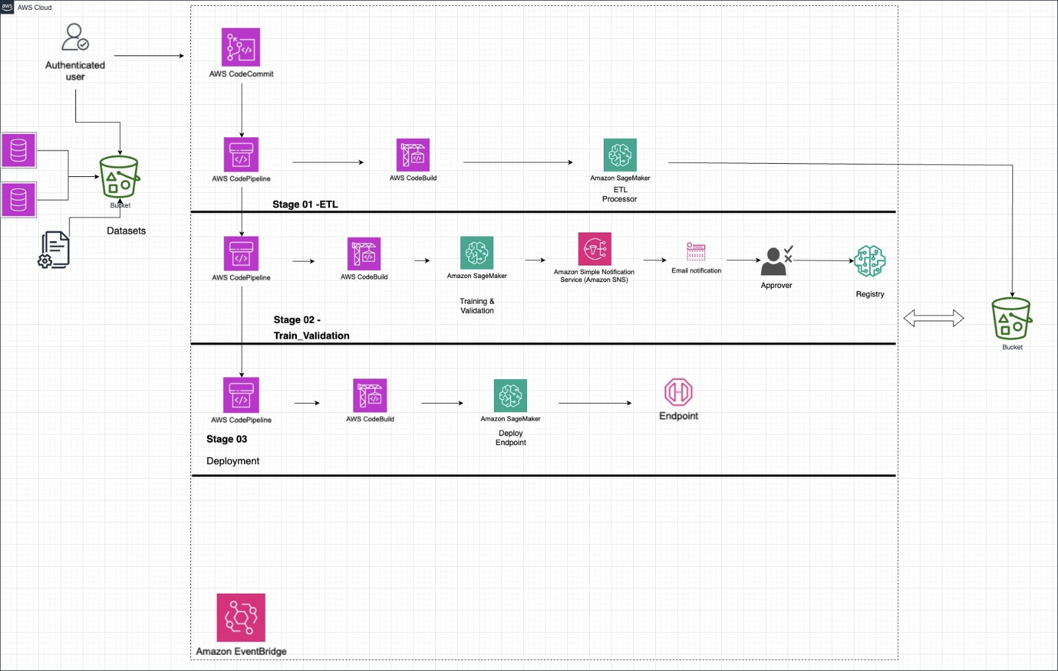
Architecture

Slide 19

Thank You.
LLM_BOT

